Slide 1

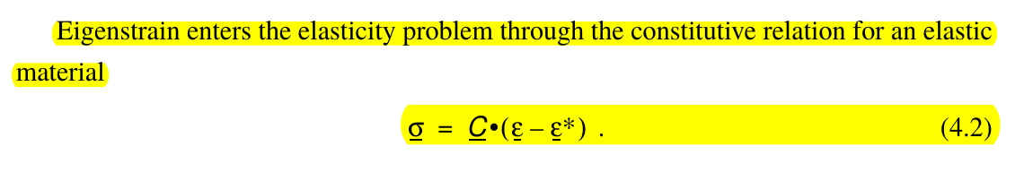
Hookean Law

Slide 2
What is Eigen Strain and Eigen Stress?
In the field of continuum mechanics, an eigenstrain is a kind of strain (deformation) produced without external forces (stress-free). Thermal expansion and phase changes are eigenstrains. An eigenstrain can produce a self-equilibrated stress field called "eigenstress". As an example, if a piece of metal is not uniformly heated, the inhomogeneity of the thermal expansion (the incompatibility of the eigenstrain) induces stresses in the metal, without external forces: the eigenstress.

Slide 3
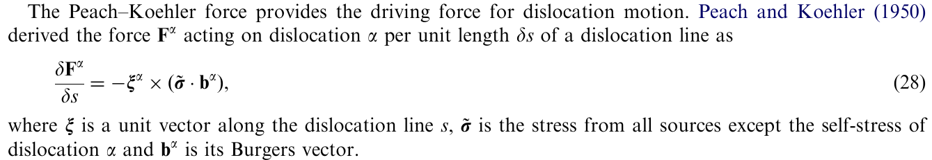
Peach – Koehler force

Slide 4
Eigen-strain
In the field of continuum mechanics, an eigenstrain is a kind of strain (deformation) produced without external forces (stress-free).[2] Thermal expansion [3] and phase changes are eigenstrains.
An eigenstrain can produce a self-equilibrated stress field called "eigenstress".
As an example, if a piece of metal is not uniformly heated, the inhomogeneity of the thermal expansion (the incompatibility of the eigenstrain) induces stresses in the metal, without external forces: the eigenstress.

Slide 5
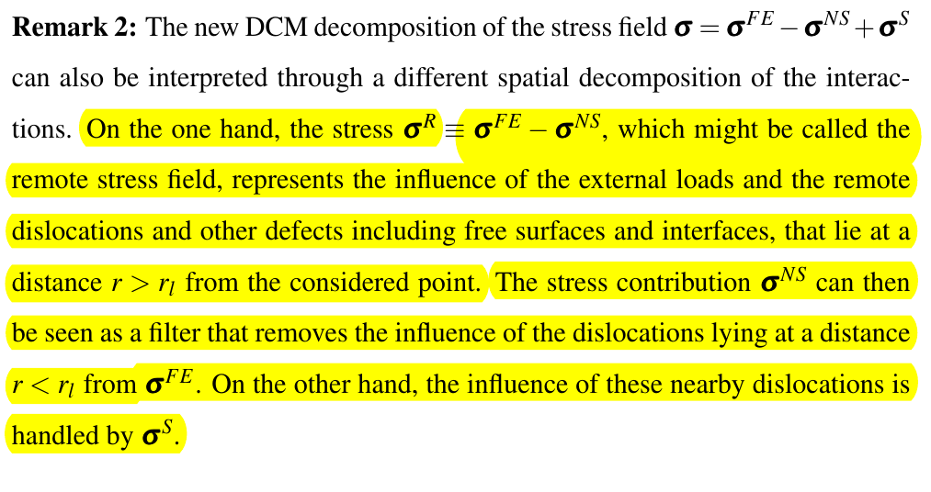
DCM

Slide 6
Wei Cai Formulation
We develop a non-singular, self-consistent framework for computing the stress field and the total elastic energy of a general dislocation microstructure.
The expressions are self-consistent in that the driving force defined as the negative derivative of the total energy with respect to the dislocation position, is equal to the force produced by stress, through the Peach–Koehler formula.
singularity intrinsic to the classical continuum theory is removed here by spreading the Burgers vector isotropically about every point on the dislocation line using a spreading function characterized by a single parameter a, the spreading radius.
A particular form of the spreading function chosen here leads to simple analytic formulations for stress produced by straight dislocation segments, segment self and interaction energies, and forces on the segments.
For any value a>0, the total energy and the stress remain finite everywhere, including on the dislocation lines themselves.

Slide 7
Modifications
The modification we propose is to distribute the Burgers vector about every point on the line: the line now becomes the locus of the centers of the Burgers vector distributions.

Slide 8
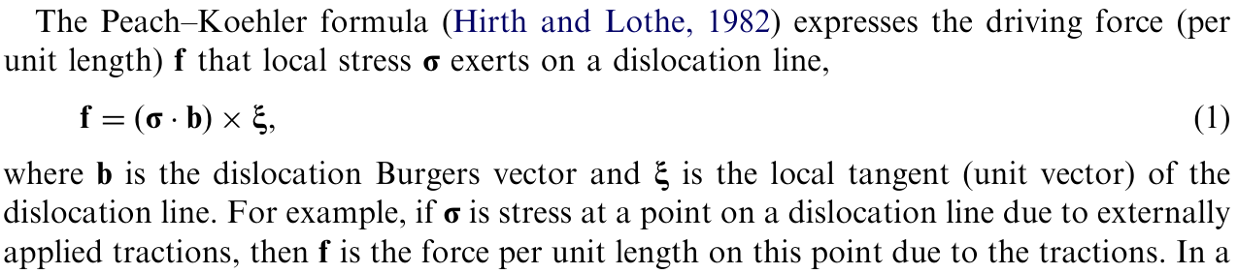
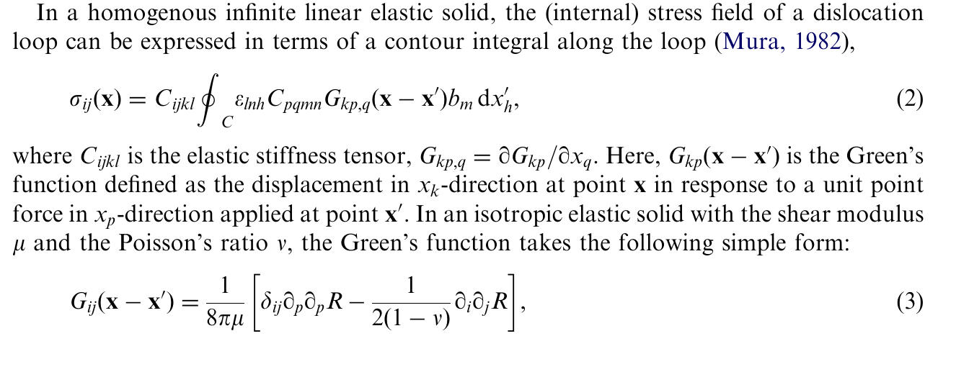
Contd…...

Slide 9
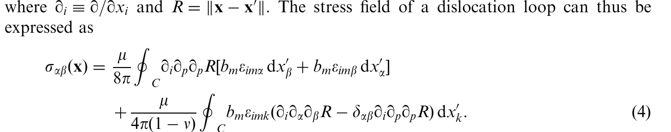
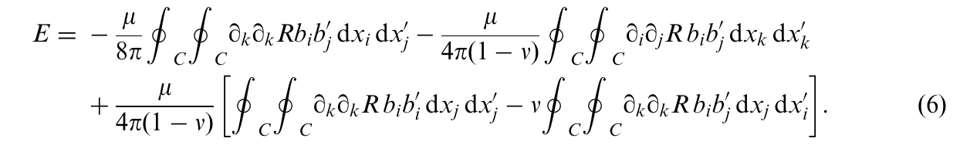
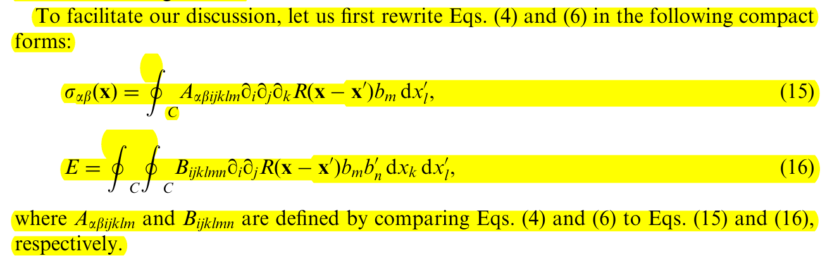

Slide 10
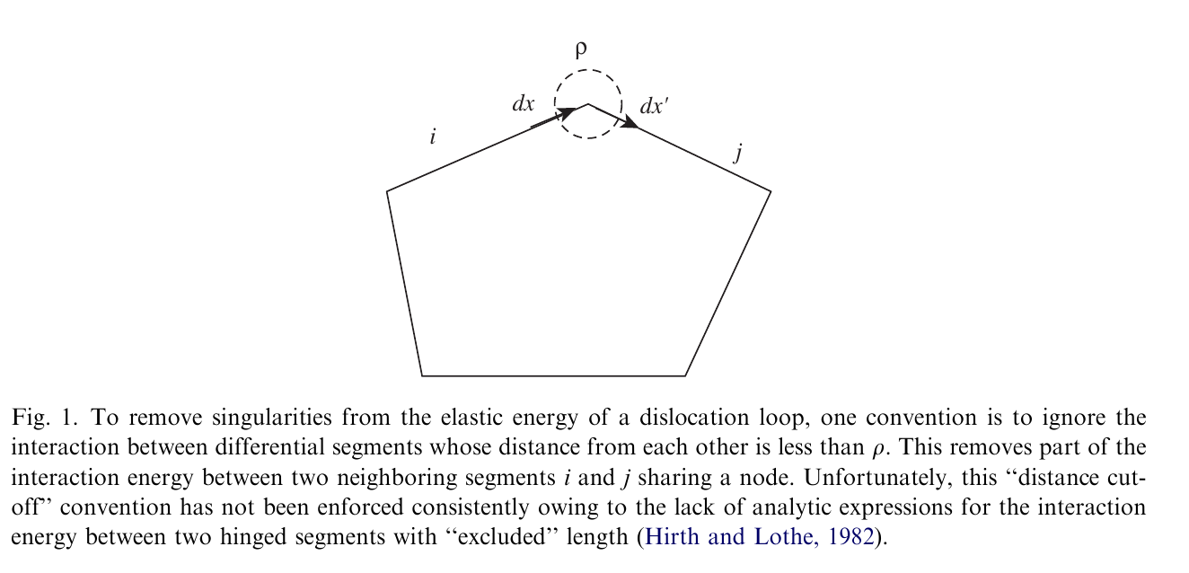
Hirth and Lothe Approach

Slide 11
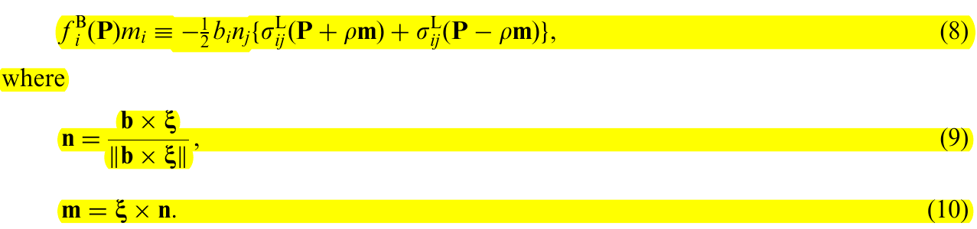
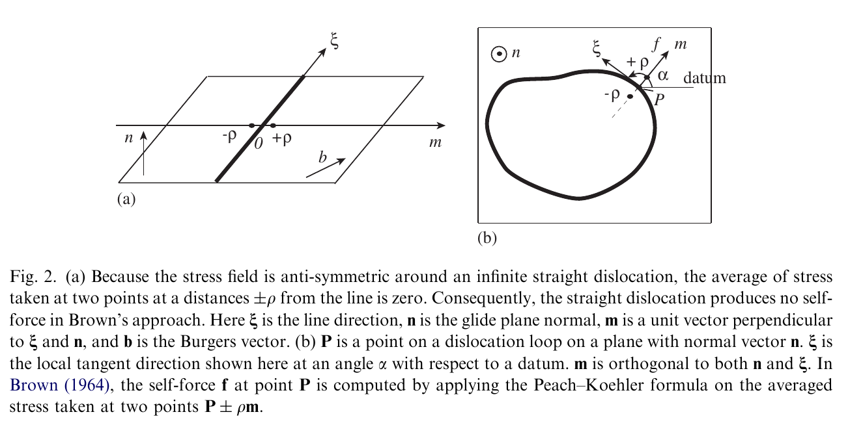
Brown’s Approach
One limitation of Brown’s approach is that it defines only the glide component of the
Peach–Koehler force, i.e. the projection of the total force on the glide direction m.
NOT SELF- COnsistent

Slide 12
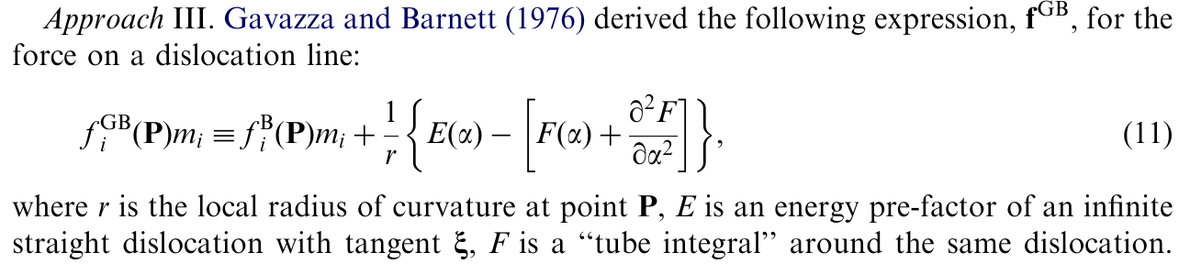
Approach 3

Slide 13
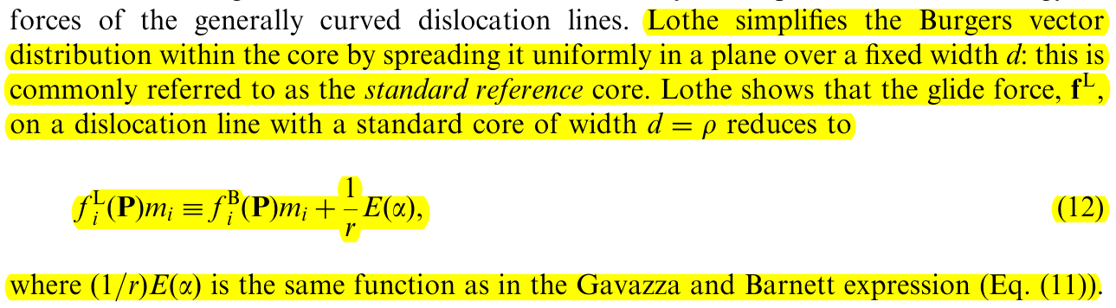
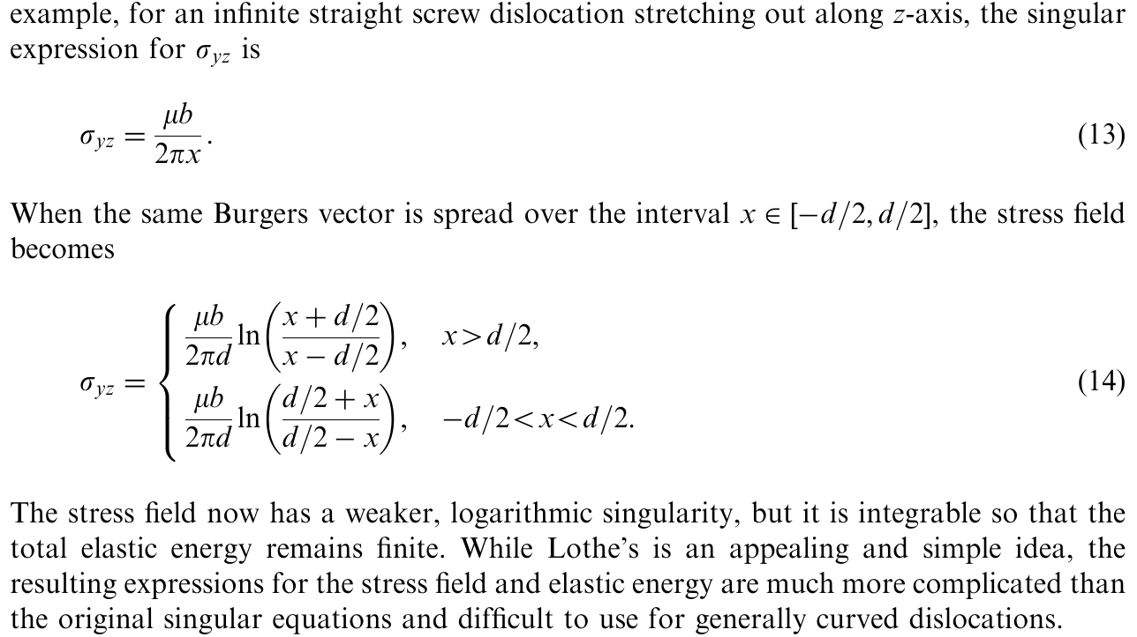
Lothe Approach :4

Slide 14
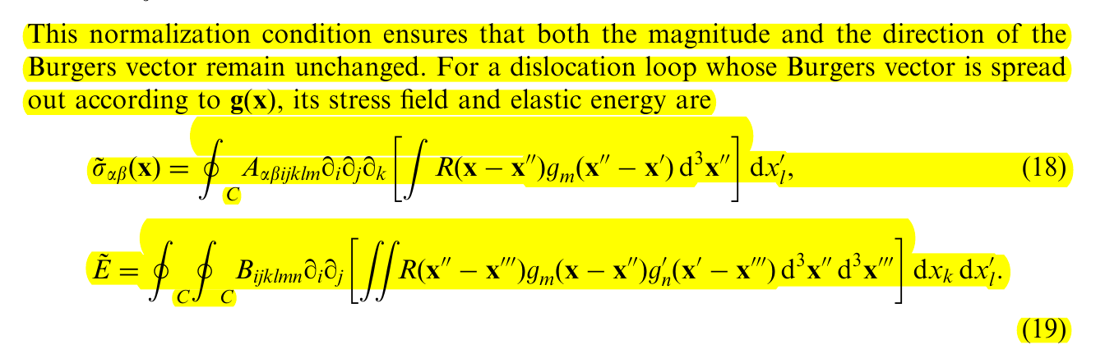
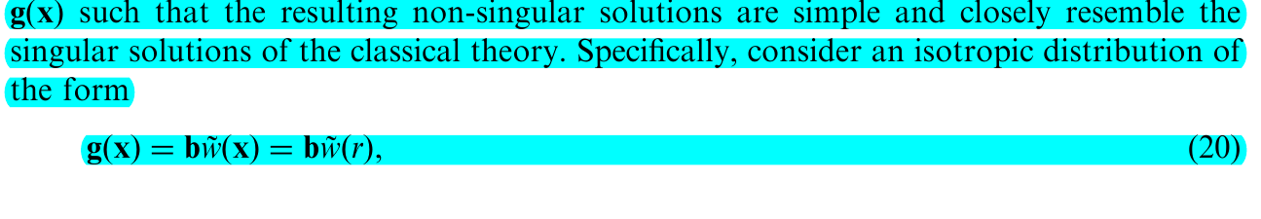
Start of our theme

Slide 15
Mesoscopic simulations of plastic deformation
The simulation codes that exist to date can be classified into two different types, depending on whether dislocation dynamics and reactions are simulated on a discrete lattice or in the continuum
In short, the use of an underlying lattice significantly improves the computing efficiency and is there-fore, better suited for the modeling of large strains and/or large volumes.
In contrast, continuous models describe more accurately the elastic fields near the dislocation cores and are usually preferred for a detailed analysis of elementary configurations.

Slide 16
Theory of Dislocations
The theory of two-dimensional problems (infinite straight dislocations) is in reasonably good shape. To solve three-dimensional problems (e.g. to find the strain field of a dislocation loop) one in effect needs to know the elastic Green's function, that is, the response of the anisotropic medium to a point force.

Slide 17
Super-position principle
-Mesoscopic Dislocation by Devincre
The first method makes use of the superposition princi-ple [33,34]. The stress field solution of the boundary value problem is obtained as the sum of two contributions.
The first one represents the solution for dislocations in an un- bounded continuum and the other one is the complementary elastic solution needed to satisfy equilibrium at the external and internal boundaries.
This last contribution is computed numerically by a finite element (FE) method. Such a nu-merical solution may seem rather simple to implement, but attention must be paid to the fact that it requires a refined measurement of the displacements at the boundaries during deformation.

Slide 18
DCM
Discrete continuous model (DCM) is based on a coupling between a DD code and a FE code, each of them functioning with its own time step (typically of 10−9 s for the DD code and 10−8 s for the FE code).
On the one hand, the DD code solves the dynamics and the local reactions of discrete dislocation lines for a given state of stress in the simulated volume and yields the resulting plastic strain increment.
On the other hand, the FE code computes the displacement field solution of the mechanical problem, making use of the plastic strain field yielded by the DD simulation.
Thus, the DD code serves as a substitute for the constitutive form used in the usual FE framework.

Slide 19
Contd...
More precisely, the coupling procedure involves two important steps.
First, the stresses defined at the nodes of the FE mesh are estimated at the positions on the dislocation lines where the dynamics is computed.
Next, the discrete plastic shears produced by the motion of the dislocation segments are returned to the FE mesh.
The first operation is an interpolation procedure, whereas the second one is a homogenization procedure.

Slide 20
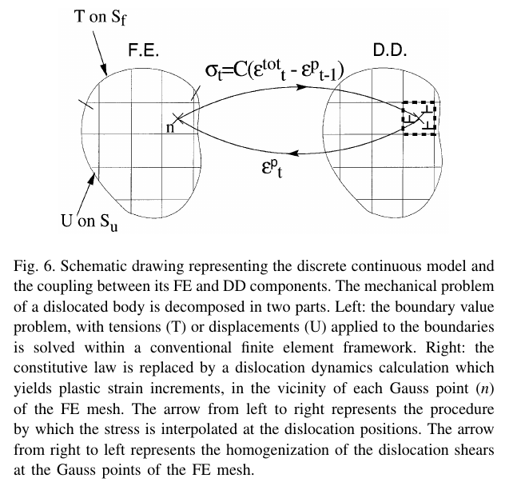
Picture on DCM

Slide 21

Elastic field regularization by Cai et al.
Cai et al. (2006) developed a theory that yields non-singular interaction energy and stress between dislocation loops in closed form. Here we shall cast the original formulation of Cai et al. (2006) into the eigenstrain framework to highlight analogies and differences with respect to the classical and gradient theories. To this end, instead of a Volterra eigen- distortion, we consider the following dislocation eigendistortion and the corresponding dislocation density tensor:

